Slide 1

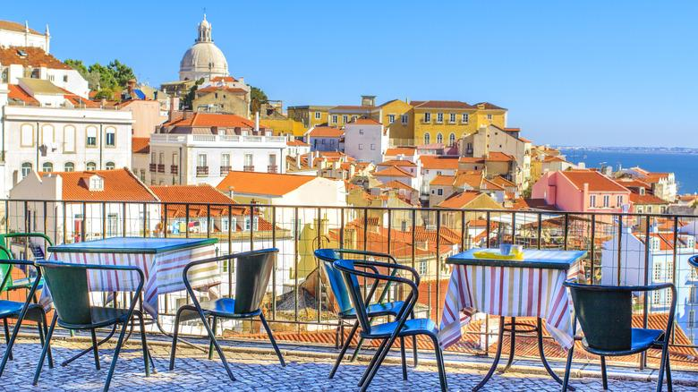
Welcome to the Lisbon City Hotel
www.lisboncityhotel.com

Slide 2

Lisbon City Hotel
Cancellation Analysis
www.lisboncityhotel.com
Grup E - Team 2
[Ika Zubaida, Mark Billiarder Manasye Siregar, Munik Hasibuan, Suparta, Rifa Fardhianty]

Slide 3
HOTEL OVERVIEW
166 Countries
8 Customers Segmentation
40,57 % Cancellation
From total booking of 79,3K
on Period 2015 - 2017
183 Agent
5 Booking distribution channel

Slide 4
OBJECTIVES
1
To find Characteristic cancellation.
2
To find correlation among lead-time, deposit, distribution channel, market segmentation to cancellation.
3
To determine cancellation clustering
4
To create forecasting cancellation rate.

Slide 5
METHODOLOGY
Data Cleaning and Preparation
Data Collection
Descriptive Analysis
Visualisation
Recommendation

Slide 6
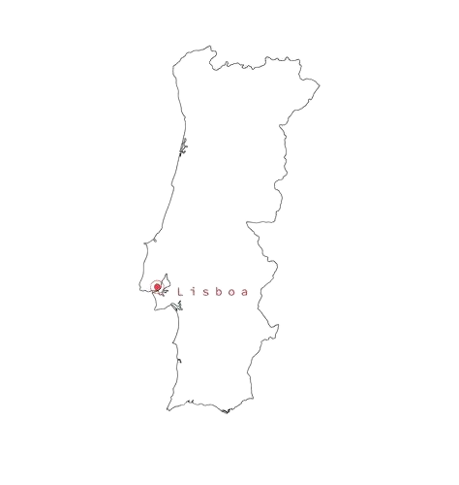

BACKGROUND SITUATION
Location
Lisbon City Hotel, Portugal
The city hotel finds itself operating amidst a dynamic backdrop that contributes to its distinct background situation, marked by a noteworthy phenomenon —
a high cancellation rate although a booking demand is high.

Slide 7
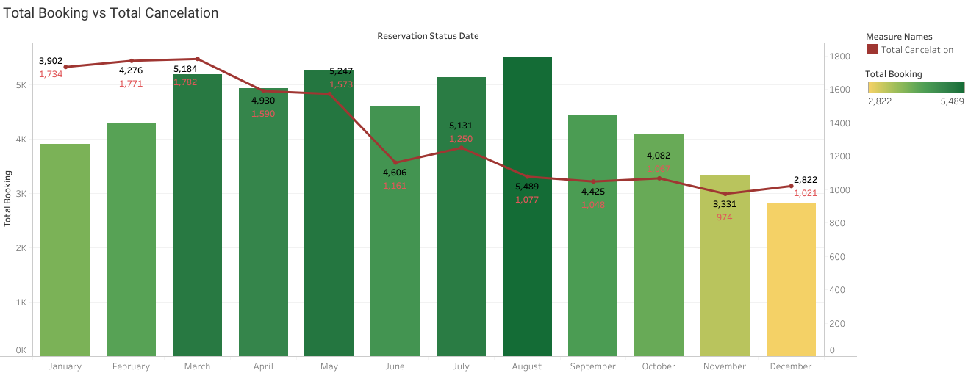
TOTAL BOOKING VS TOTAL CANCEL
www.lisboncityhotel.com
Monthly cancellation have steady level as the year progresses. January had the highest number of cancellation by total booking.

Slide 8
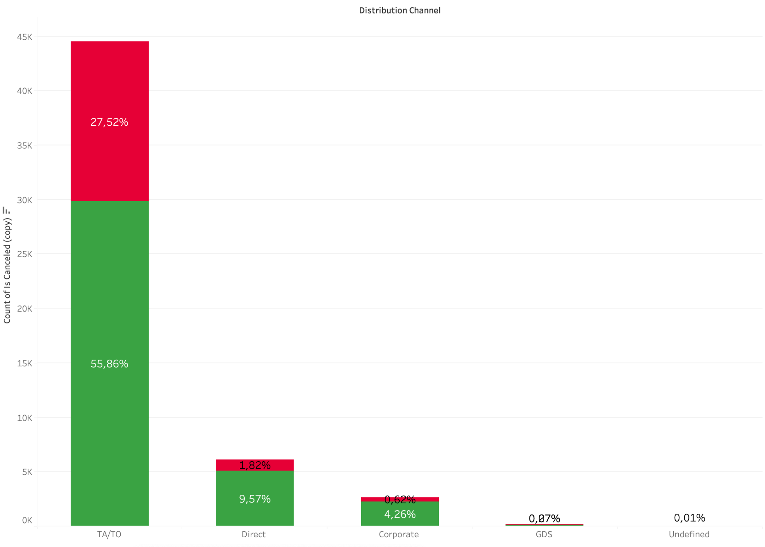
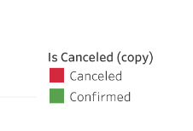
DISTRIBUTION CHANNEL - TOTAL BOOKING
In distribution Channel, TA/TO (travel agent / tour operator), contributes the highest booking and also cancellation numbers.
TA/TO contributes:
55,85% of total booking
and 27,52% of cancellation for City Hotel

Slide 9
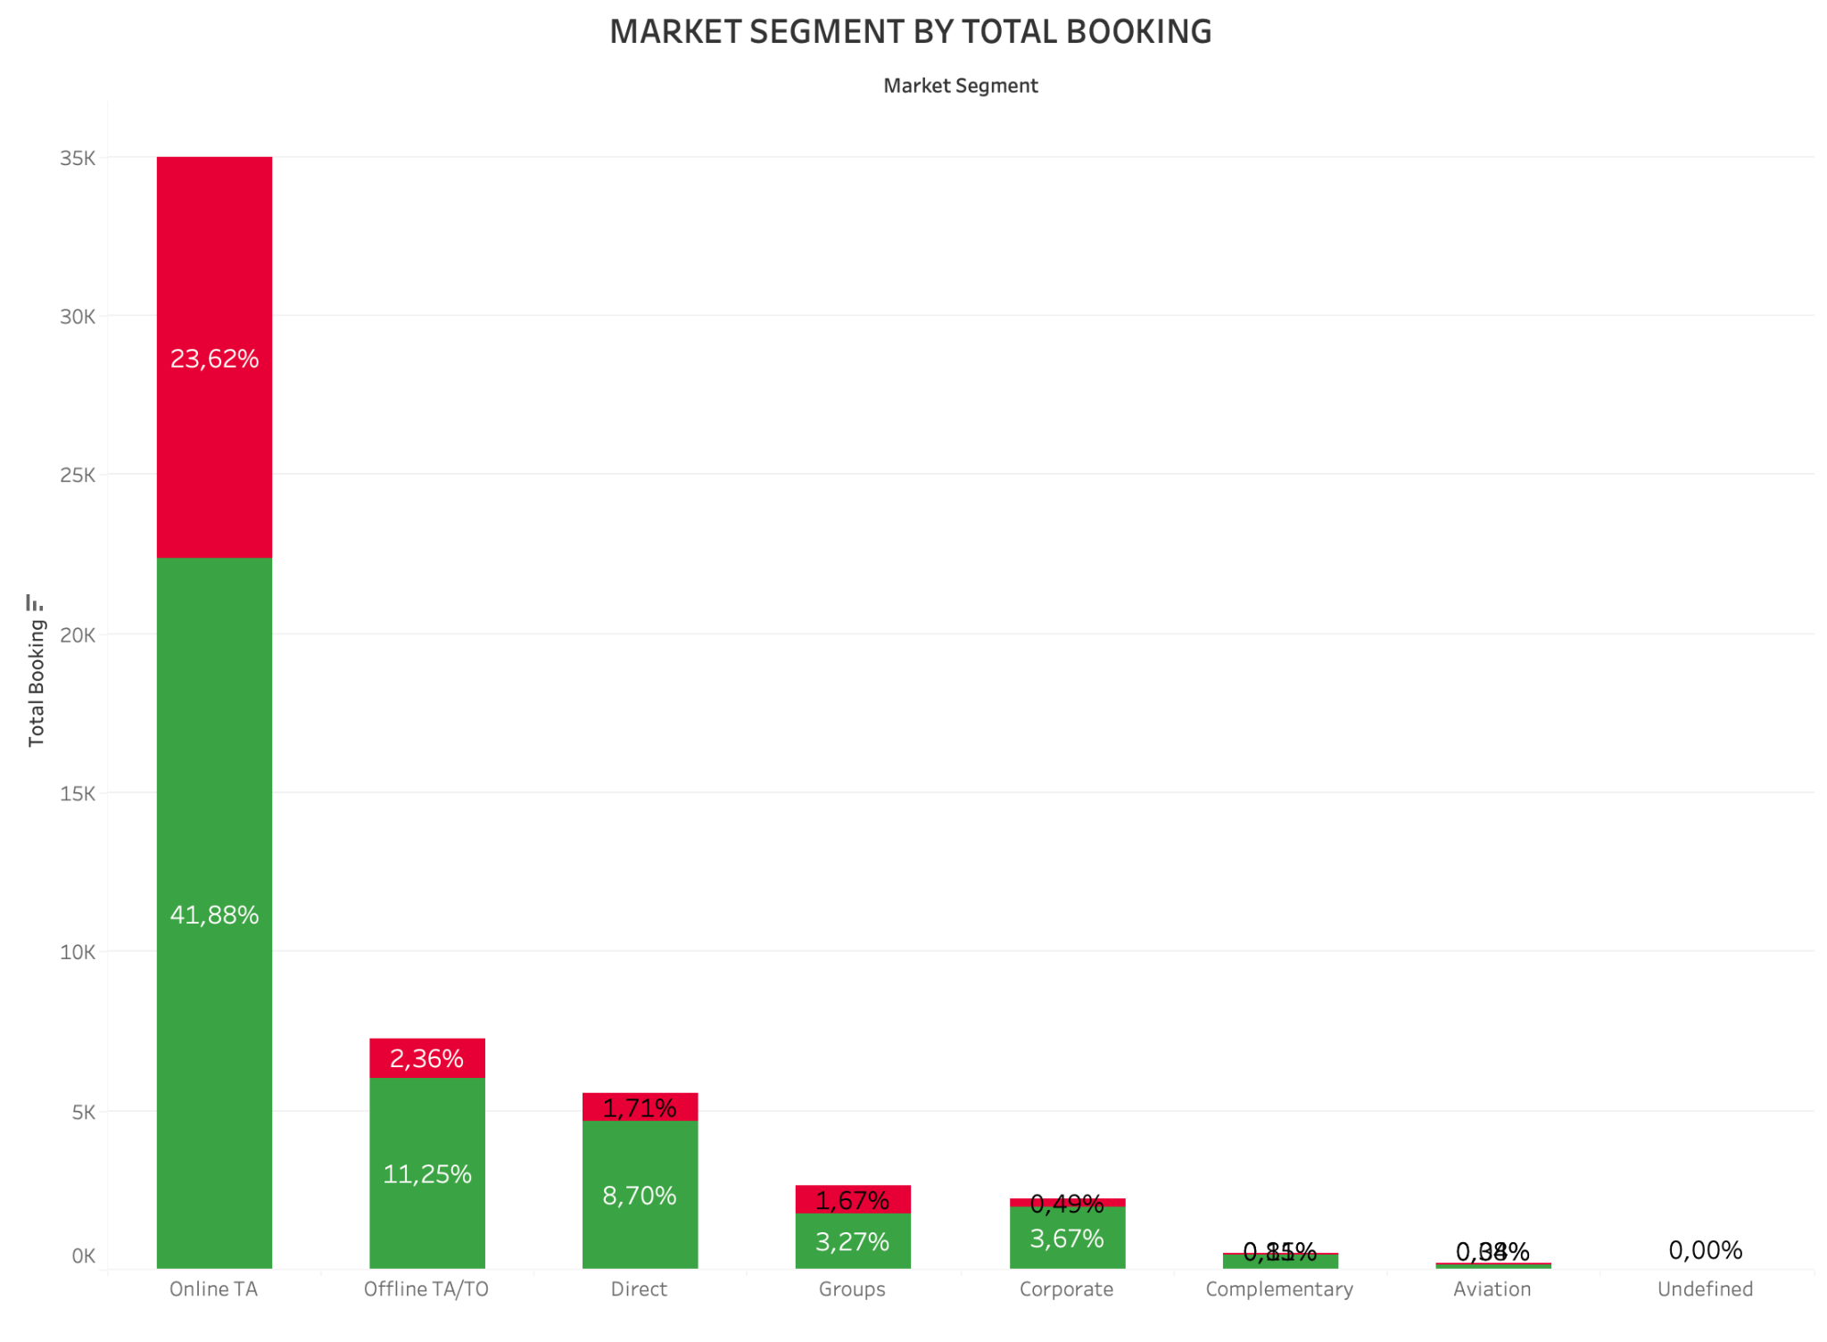
MARKET SEGMENT - TOTAL BOOKING
In market segment, Online TA, contributes the highest booking and also cancellation numbers.
Online TA contributes:
41,88% of total booking
and 23,62% of cancellation for City Hotel

Slide 10

Exploratory Data

Slide 11
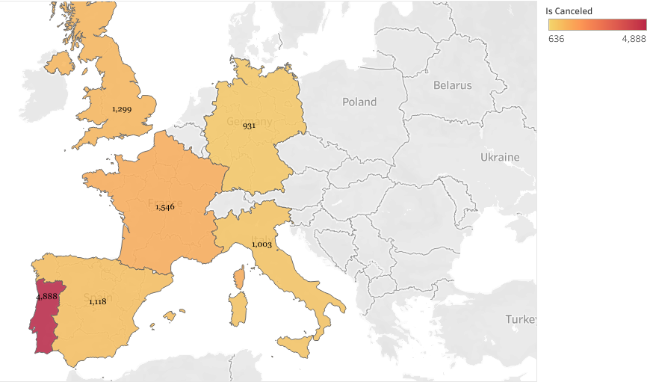
TOP 6 CANCELLATION BY COUNTRY
The country with the highest number of cancellations are spread across Europe and the highest country is Portugal (PRT) with 4888 cancellations.
Top 6 Cancellation by Country

Slide 12
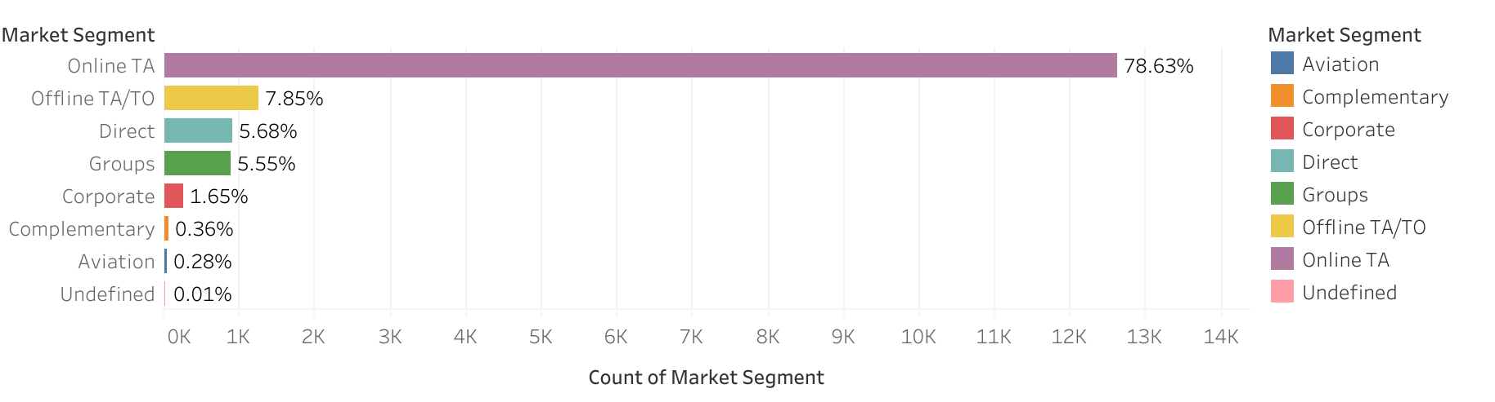
CANCELLATION - MARKET SEGMENT
Overall the percentages suggest that cancellation are more common when booking are made through online TA. It is around 78,63% of cancellation.

Slide 13
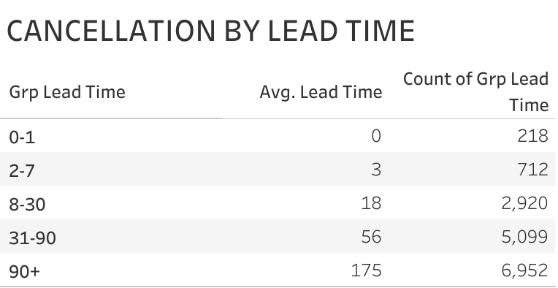
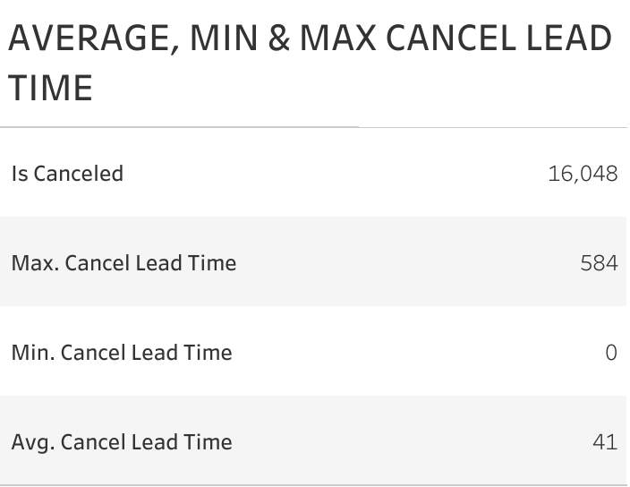
CANCELLATION - LEAD TIME
Lead time is days count between booking date to arrival date.
The longer days count takes between booking date and arrival date, the more likely cancel will be made.
The highest cancellation are made on 90+ days lead time: 6.952 cancellation. Average lead time for cancellation to be made is 41 days.

Slide 14
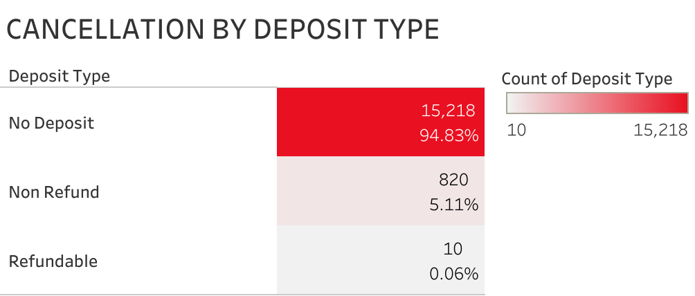
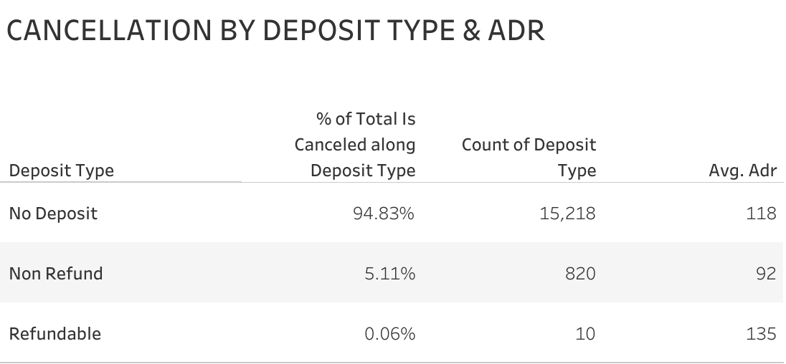
CANCELLATION - DEPOSIT TYPE - ADR
Most of booking in City Hotel are made with No Deposit.
Cancellation by No Deposit hits 94,83% of total cancel.
And the average ADR (average daily rate) for that cancellation is 118 euro

Slide 15
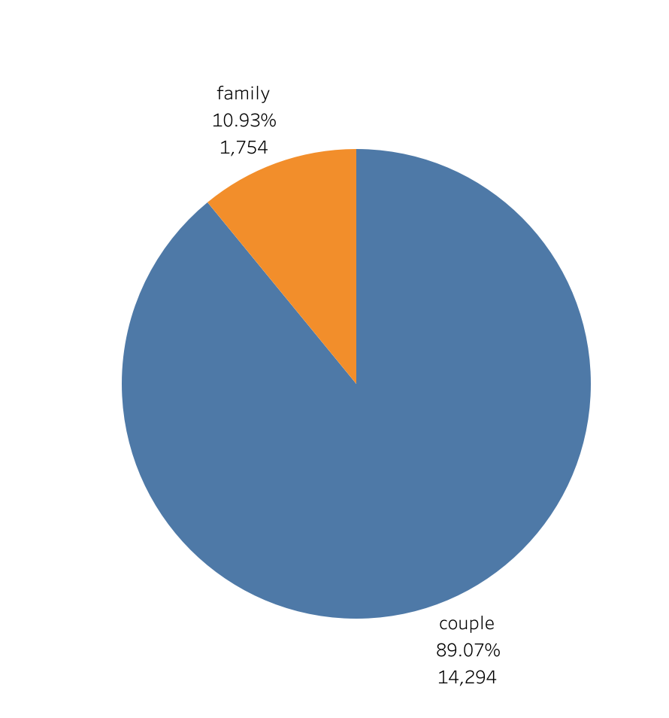
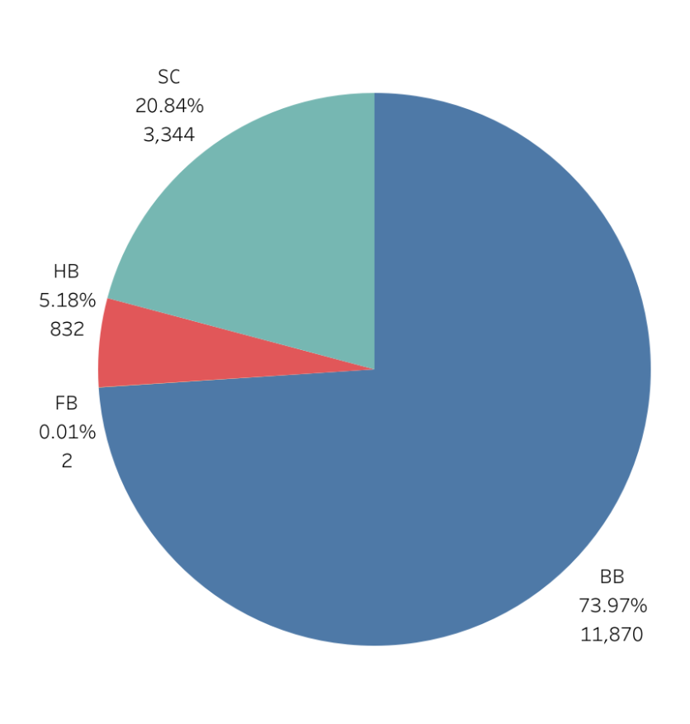
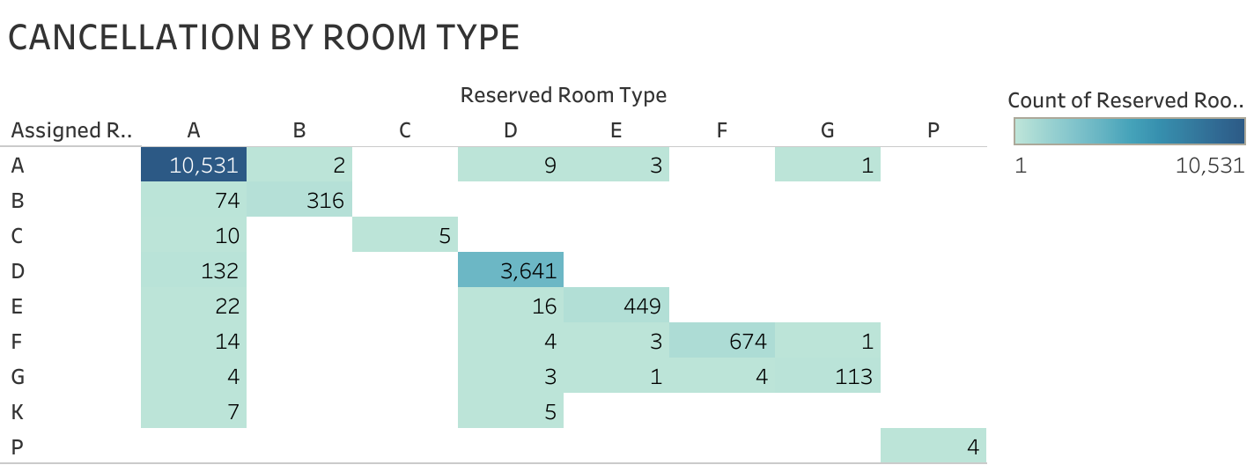
CANCEL CHARACTERISTIC
CANCELLATION BY GUEST TYPE
CANCELLATION BY MEAL

Slide 16
CANCEL CHARACTERISTIC
Cancel highly occurred in the month of January, February and March. And the lowest in the month of September, October, and November.
TO/TA contributes the highest cancel among 5 other distribution channel City Hotel has.
City Hotel market segment that cancel their booking dominates by Online Booking by Online Travel Agent.
The longer lead time - days count takes between booking date and arrival date, the more likely cancel will be made.
Most of booking canceled are made with No Deposit booking.
Booking cancel mostly are made by guests from Portugal itself.
City Hotel guests type that more likely made cancel their booking are couples.
Cancellation are made the highest on bookings with type of meal: breakfast only (BB = bed & breakfast) and no meal (SC=self catered).
Type of room that has the most canceled are: A & D with the average ADR of 118 euro.

Slide 17
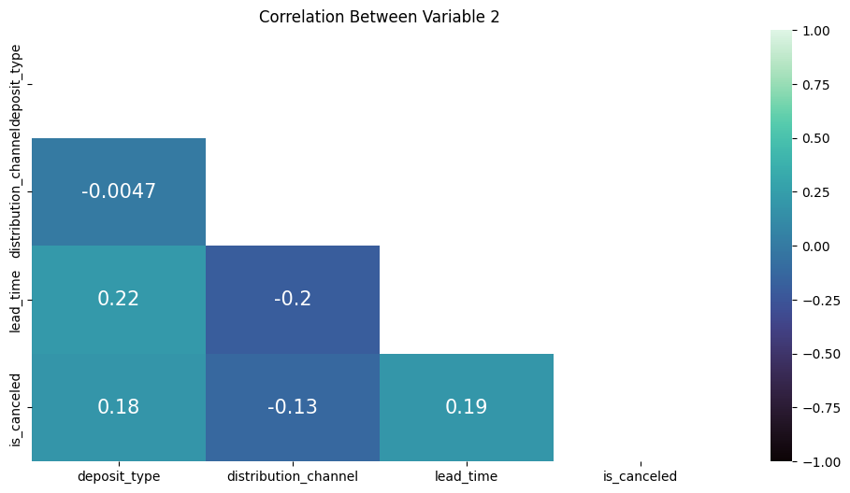
CORRELATION
In practical terms, a correlation coefficient between -0.0047 and 0.22 is consider to be a weak correlation between two variables.
It is indicates that there is virtually no meaningful relationship between the variables being analyzed. This correlation value suggests that changes in one variable (such as lead time or cancellation rates) are not associated with consistent changes in the other variable, making any impact or trend almost negligible.
Positive correlation with lead-time; In practical terms, a correlation coefficient of 0.19 suggest that there is a tendency for cancellation rates to increase slightly as lead time increases. While this effect is not very strong, it could still influence how you approach lead time when considering cancellation policies, guest communication strategies, and revenue management tactics.
Notes:
coeficient

Slide 18
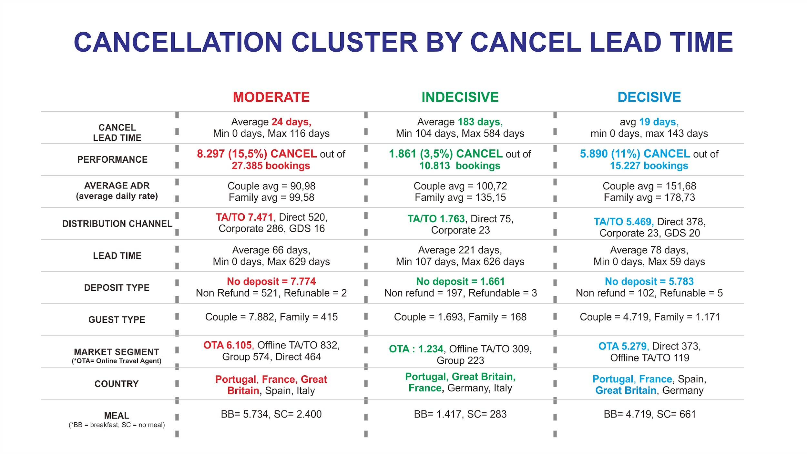
CLUSTERING

Slide 19
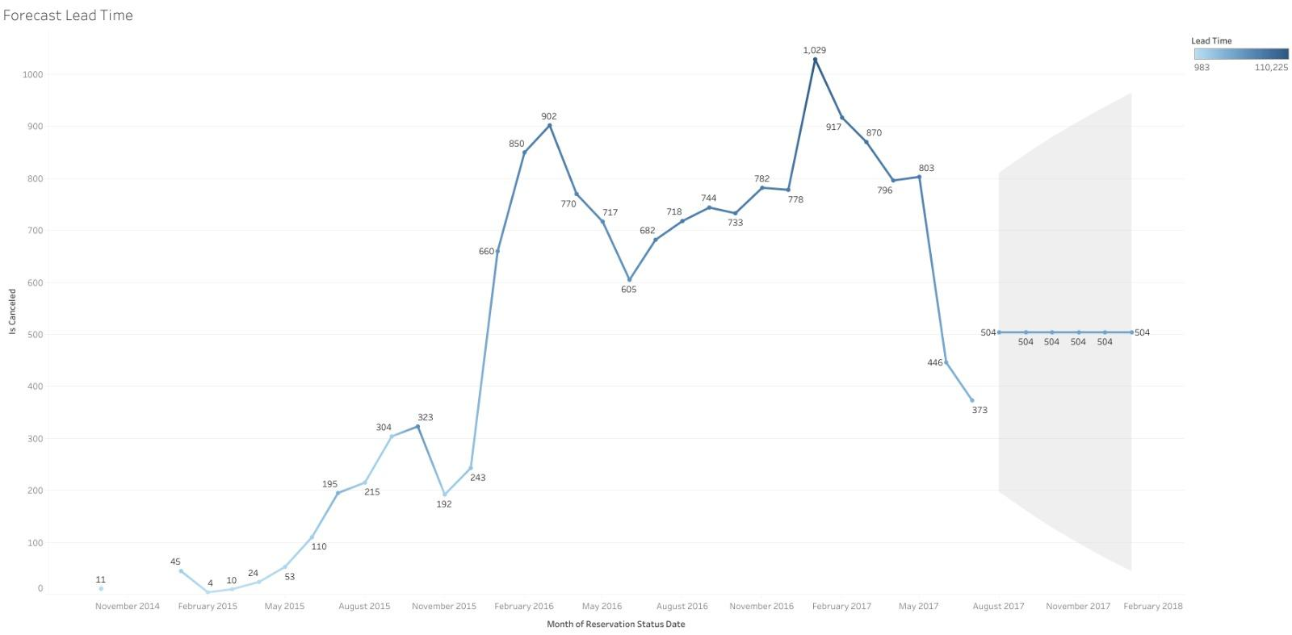
FORECASTING
Forecasting Lead-time cancellation monthly
There are recurring trends, such as cancellations during 3 month.

Slide 20
RESULT
Cancel Rate Influenced by a country where Portugal is one of the highest cancel among the countries.
In Market Segment, Online Travel Agent is the biggest contributor to cancel rate.
Among 5 Distribution Channel, TO/TA has the highest cancellation rate.
No Deposit is one of the reasons for the occurrence of high cancellations and following the existing Market Segment.
Bookings with a longer Lead Time tends to be canceled.
Notes:
1. Customizing a booking options in OTA.
(shorter lead time, max of 6 months).
2. Create a package of booking deal such as: promo price for room without breakfast, or if pay deposit pay in lesser price.
3. Create a more interactive, friendly city hotel site to attract more guests to book directly to city hotel Kalo gue rekomendasinya: (buat nambahin rekomendasi, buatin kalimat cakepan aja yak)
1. Customizing a booking options in OTA.
(shorter lead time, max of 6 months).
2. Create a package of booking deal such as: promo price for room without breakfast, or if pay deposit pay in lesser price.
3. Create a more interactive, friendly city hotel site to attract more guests to book directly to city hotelKalo gue rekomendasinya: (buat nambahin rekomendasi, buatin kalimat cakepan aja yak)

Slide 21
RECOMMENDATION
Hotels should consider launching attractive targeted marketing campaigns such as Special Packages & Promo, Special Events, etc. to attract more customers to book through hotel direct channel such as City Hotel’s sites.
Work closely with Travel Agent to implement strategies that encourage committed booking.
Deposit type and Lead Time are indicators of high cancel rates. Reviewing and updating policies with travel agent online and offline to limit the length of Lead Time. And a more attractive package for booking with deposit.

Slide 22
APPENDIX
Link Dataset
Link Eda
Link Clusters

Slide 23

THANK YOU
FSDA_RevoU_May23
Grup E - Team 2

